Slide 1
SAVE ANGELICA CREEK from ROAD SALT

Slide 2
A problem across the world
An invisible freshwater pollutant - salt - has increased in natural fresh water sites over the past 50 years and places our freshwater environment at risk.
Salt is an invisible freshwater pollutant
Road salt is the main cause of salt pollution in PA streams and groundwater
Road salt dissolves in water and enters streams quickly via runoff from roads and parking lots, and ALSO slowly enters the soil and groundwater
The problem is getting worse
The Angelica Creek Watershed Association (ACWA) stream monitoring program has detected risk for our community
Innovative solutions can balance protection of our streams and drinking water with community safety

Slide 3
Why is salt a problem?
Excess salt is harmful to freshwater animals and plants
Federal standards help us understand harmful levels of salt
Water pollution can occur from a sudden acute surge of salt, such as runoff from a winter storm
Adverse impacts can also occur from chronically elevated salt levels in soil and groundwater
Road salt also speeds up rusting of metal and corrosion of concrete and causes millions of dollars in damage to infrastructure and personal property

Slide 4
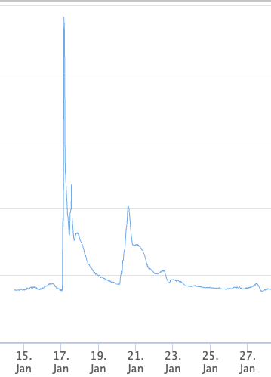
Angelica Creek - salt level rise after snow storm
Salt (as chloride) level peak 8 times above baseline level
Sensors continuously measure salt levels in Angelica Creek
860
Peak Chloride 653
640
Measures from a January 2022 snowstorm reveal dramatic acute rise in salt levels
Chloride level mg/L
Short term (acute) salt levels above 640 mg/L have been associated with potential injury to the more sensitive aquatic species, while levels above 860 mg/L risk severe short term injury
Baseline Chloride 80
Monitoring Date

Slide 5
Angelica Creek - Chronic Elevation of Salt Levels
Continuous measurement of salt mineral ions at 3 sites along Angelica Creek demonstrate elevated levels up to 4X predicted levels
Sensors within Angelica Creek measure conductivity, mineral ions within water, from which chloride levels can be determined
Salt that flows from roads, parking lots and other impervious surfaces does not break down. It enters the ground water which then feeds our streams.
Low level injury
Current levels of salt have been shown to be harmful to the “macroinvertebrate” insects upon which fish and other aquatic life feed
Stream conductivity microS/cm
Fortunately, Angelica Creek is not currently in as much risk as many nearby streams
However, increasing “salt pollution” is occurring throughout the Northeast. Without local collaboration to address this problem, we can expect the process to worsen.
Predicted Natural Conductivity
Measured Average Summer Conductivity - 2022
PREVENTION is much more effective and COSTS LESS than correction
Notes:
Takeaway: when salt gets into the groundwater it’s more impactful and also harder to remedy, and it can be prevented here in A creek and that’s good

Slide 6
What can we do?
Homeowners and residents
Shovel First: Shovel before you salt and right after it snows to reduce the need for salt
Reduce and Reuse: Use just enough salt to melt ice (one 12oz cup of salt per 20 ft of driveway or 10 sidewalk squares). After snow melts, sweep up and reuse the salt that remains
Consider: Use sand or crushed limestone instead of salt or a 1:1 sand/crushed limestone to road salt mixture
Read the Label: Don’t use products containing urea, kitty litter, or ashes
Speak up: If you see an unprotected salt pile or excessive road salt use contact your township. Educate your neighbors about how we all can help!

Slide 7
Solutions for municipal and private property owners
Adopt more efficient mechanical snow/ice removal methods such as live edge plows
Apply pre-storm salt brine to reduce use of rock salt
Improve efficiency of salt application and storage to reduce waste. Sweep up salt after use.
Adjust brine and salt applications to match snow/ice expectations and traffic volume

Slide 8
Looking forward
Salt application is important to protect residents from snow/ice risks.
Salt applications are often greater than needed to assure safety.
Proven approaches can reduce salt use, assure community safety, and save the community money!

