Slide 1
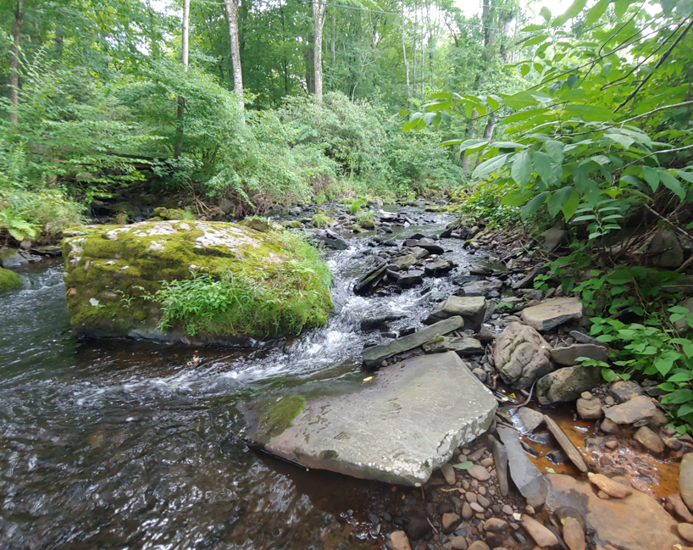


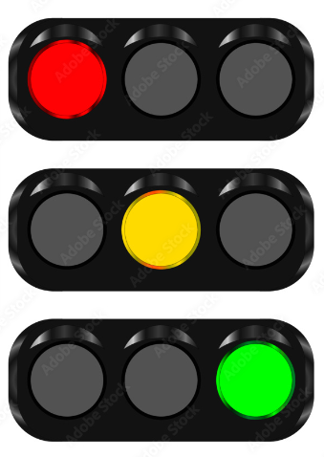
Summer water temperature and chloride snapshot data for 44 sites in the Brodhead Watershed
Prepared by David Bressler (Stroud Water Research Center) for Brodhead Watershed Association
Support from John Jackson (Stroud Water Research Center) and Keith Fritschie, NJ Trout Unlimited Volunteer
Notes:
1

Slide 2
Baseflow chloride concentration as a stressor to aquatic life (More Protective)
Red >50 mg/l = Increasing Stress/Hazard
Yellow = 30-50 mg/l = Exceeding natural conditions
Green <30 mg/l = Upper range of natural conditions
Version 1.0
50 mg/l hazard/stressor threshold (Maryland Biological Stressor Identification Process, 2009; OH EPA/Miltner 2021); 30 mg/l upper limit of regional natural range (Griffith 2014; historic data, Stroud Water Research Center)
https://stock.adobe.com/images/traffic-light-red-yellow-green-lights-go-wait-or-slow-stop-international-traffic-light-s-day-applique-vector-design-illustrations/211926764

Slide 3
Baseflow chloride concentration for 44 sites in the Brodhead watershed (More Protective)
Increasing Stress/Hazard
Chloride (mg/l)
Exceeding natural conditions (30-50 mg/l)
Upper range of natural conditions (<30 mg/l)
Synoptic sampling (i.e., “snapshot”) conducted August 9-10, 2023; Chloride numbers generated by converting snapshot conductivity readings using conductivity-chloride rating curve from historic BWA data.

Slide 4
Baseflow chloride concentration as a stressor to aquatic life (Less Protective)
Red >120 mg/l = Chronic Toxicity
Yellow = 50-120 mg/l = Increasing Stress/Hazard
Green <50 mg/l = Lower Risk/Natural Conditions
120 mg/l chronic toxicity threshold (Canadian Council of Ministers of the Environment, 2011); 50 mg/l hazard/stressor threshold (Maryland Biological Stressor Identification Process 2009; OH EPA/Miltner 2021); 30 mg/l upper limit of regional natural range (Griffith 2014; historic data, Stroud Water Research Center)
Version 2.0
https://stock.adobe.com/images/traffic-light-red-yellow-green-lights-go-wait-or-slow-stop-international-traffic-light-s-day-applique-vector-design-illustrations/211926764

Slide 5
Baseflow chloride concentration for 44 sites in the Brodhead watershed (Less Protective)
Chronic Toxicity (>120 mg/l)
Increasing Stress/Hazard (50-120 mg/l)
Chloride (mg/l)
Lower Risk/Natural Conditions (<50 mg/l)
Synoptic sampling (i.e., “snapshot”) conducted August 9-10, 2023; Chloride numbers generated by converting snapshot conductivity readings using conductivity-chloride rating curve from historic BWA data.

Slide 6
Yes/Be Gentle/No
Trout Fishing Recommendations
Red >21 C°(70 F°) = Do Not Fish
Yellow 19-21 C° (66-70 F°) = Be Gentle (no photos, barbless hooks, fast release)
Green <19 C° (66 F°) = Fish Freely
USGS SHEDS Brook trout model, NV DEP 2017, Chadwick et al. 2015, Kratzer 2013, Wehrly et al 2007; personal communication Keith Fritschie (VA DEC); PA DEP Ch 93 Water Quality Standards
https://stock.adobe.com/images/traffic-light-red-yellow-green-lights-go-wait-or-slow-stop-international-traffic-light-s-day-applique-vector-design-illustrations/211926764

Slide 7
Estimated daily high water temperature in relation to fishing recommendations for 44 sites in the Brodhead watershed
Do Not Fish >21 C°(70 F°)
Estimated daily high
water temperature (C°)
Be Gentle 19-21 C° (66-70 F°)
Fish Freely <19 C° (66 F°)
Synoptic sampling (i.e., “snapshot”) conducted August 9-10, 2023; Estimated daily high water temperature measured mid-afternoon on average or above average temperature summer day.

