Slide 1
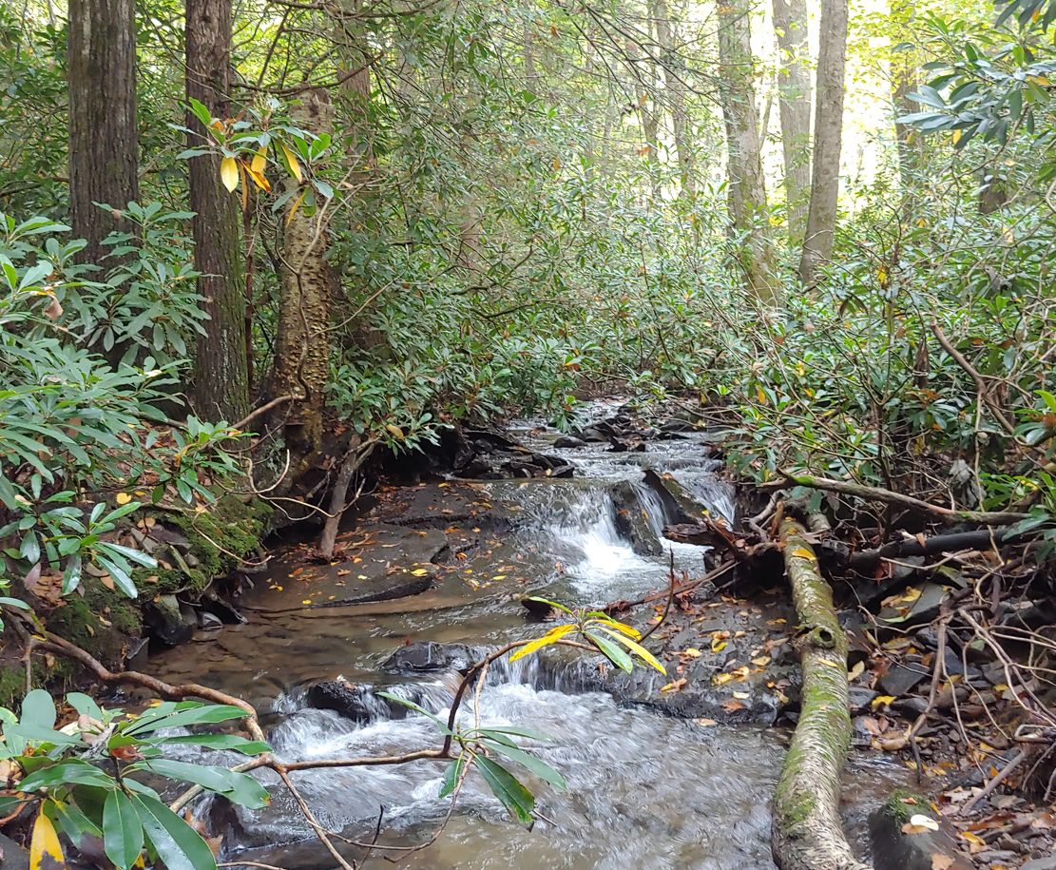
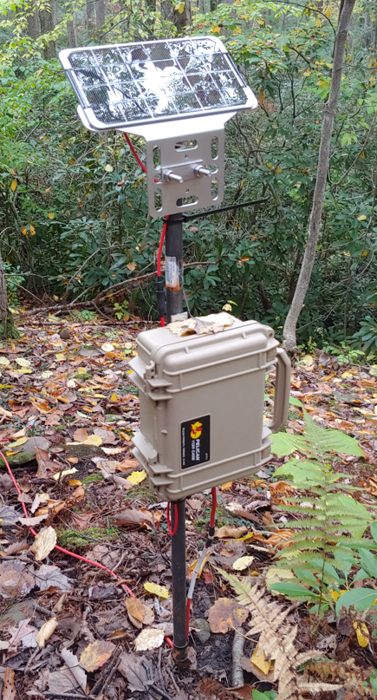
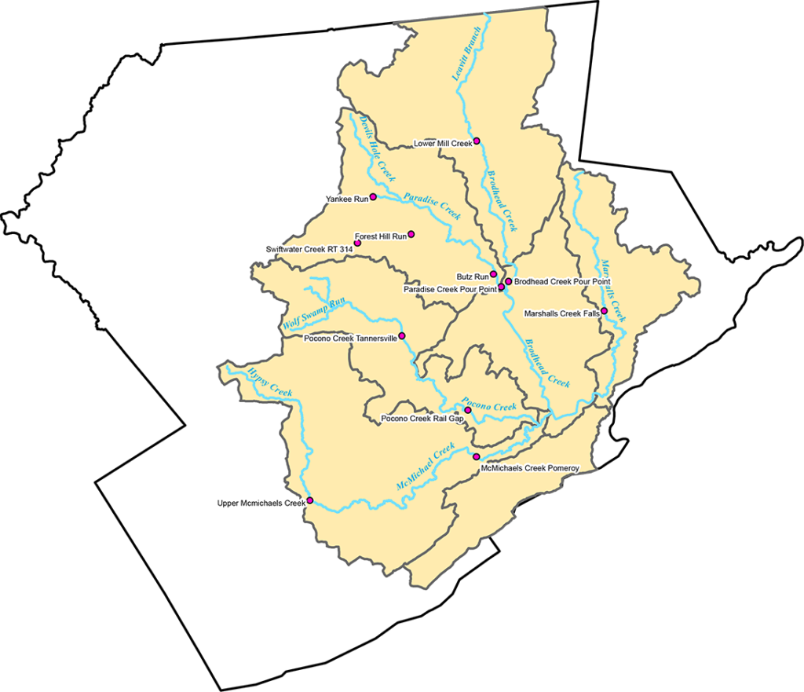

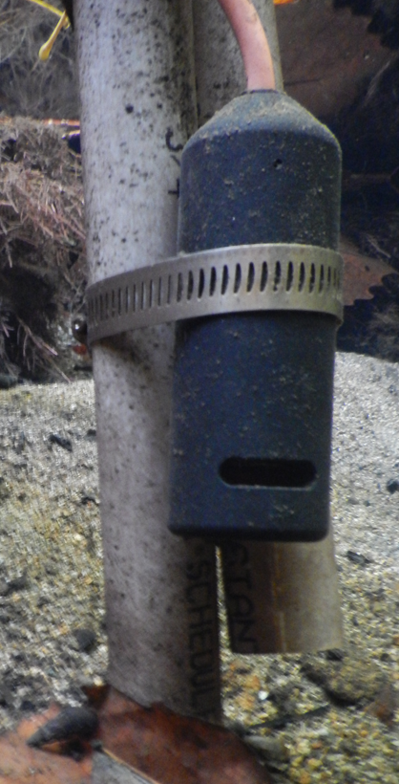
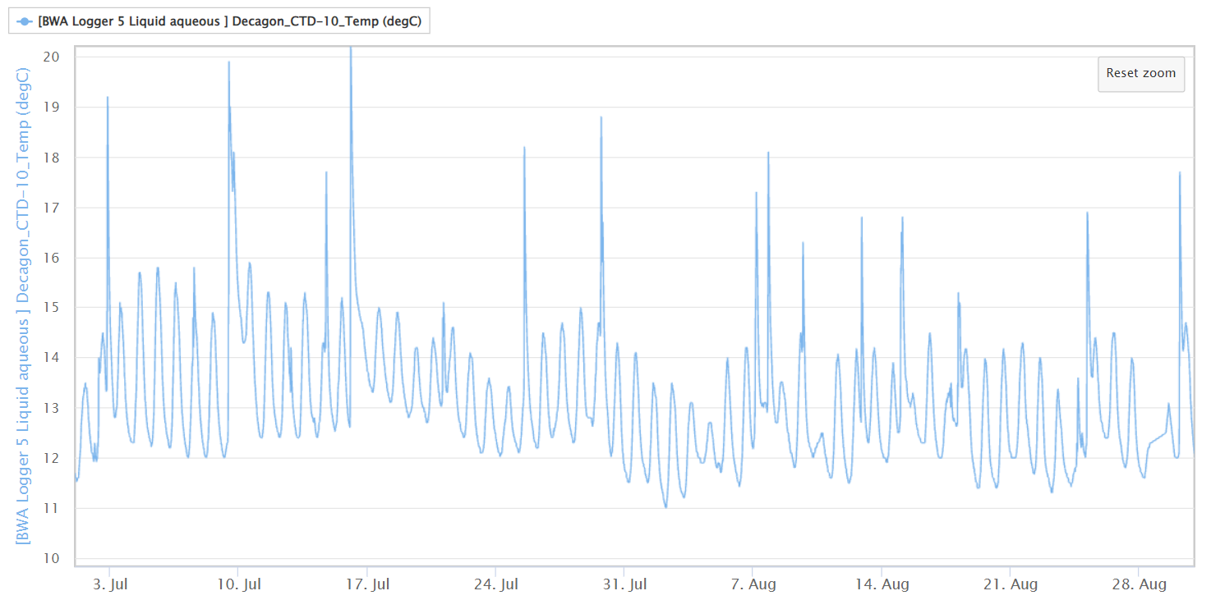




Summer water temperature for 13 continuous monitoring locations in the Brodhead Watershed
Prepared by David Bressler (Stroud Water Research Center) for Brodhead Watershed Association
Support from John Jackson (Stroud Water Research Center) and Keith Fritschie (NJ Trout Unlimited Volunteer)
Notes:
1

Slide 2
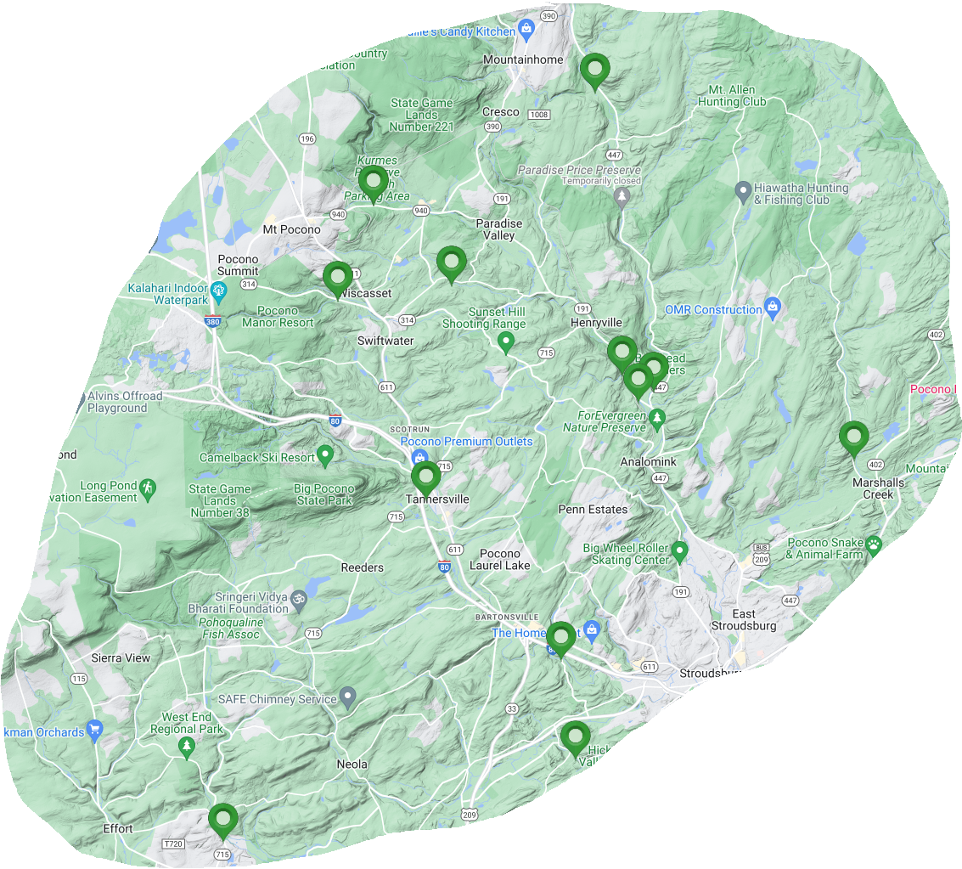
Map of 12 EnviroDIY stations and 1 USGS station
Lower Mill Creek (BWA3)
Yankee Run (BWA Logger 5)
Forest Hills Run (BWA1)
Swiftwater Creek (Swift 314)
USGS, Brodhead Creek near Analomink (01440400)
Butz Run (BWA4)
Brodhead Creek above Paradise (PKBH7S)
Paradise Creek above Brodhead (PKPC3S)
Marshalls Creek Falls (BWA10)
Pocono Creek on Tannersville Woods (BWA8)
Pocono Creek on Rail Gap (BWA6)
McMichaels Creek on Pomeroy (BWA7)
Upper McMichaels
Creek (BWA9)

Slide 3
Average Summer Water Temperature (60-day, July-Aug) – Coarse Trout Thresholds
Red >21 C°(70 F°) = Non-Sustaining
Yellow 19-21 C° (66-70 F°) = Stressful
Green <19 C° (66 F°) = Supportive
USGS SHEDS Brook trout model, NV DEP 2017, Chadwick et al. 2015, Kratzer 2013, Wehrly et al 2007; personal communication Keith Fritschie (VA DEC); PA DEP Ch 93 Water Quality Standards
https://stock.adobe.com/images/traffic-light-red-yellow-green-lights-go-wait-or-slow-stop-international-traffic-light-s-day-applique-vector-design-illustrations/211926764

Slide 4
Average Summer Water Temperature for 13 locations in Brodhead watershed (Year 2023)
Non-Sustaining, >21 C°(70 F°)
Stressful, 19-21 C° (66-70 F°)
Average Summer Water Temperature (C°)
Supportive, <19 C° (66 F°)

Slide 5
Yankee Run (BWA Logger 5)
Average Summer Water Temperature = 13.2 C°
PA DEP Maximum Stream Temperature for Cold Water Fish (66 F°, 19 C°)
Water Temperature (C°)
*Note – spikes represent warm storm water runoff, which can be stressful to trout, especially larger fish
Date, year 2023

Slide 6
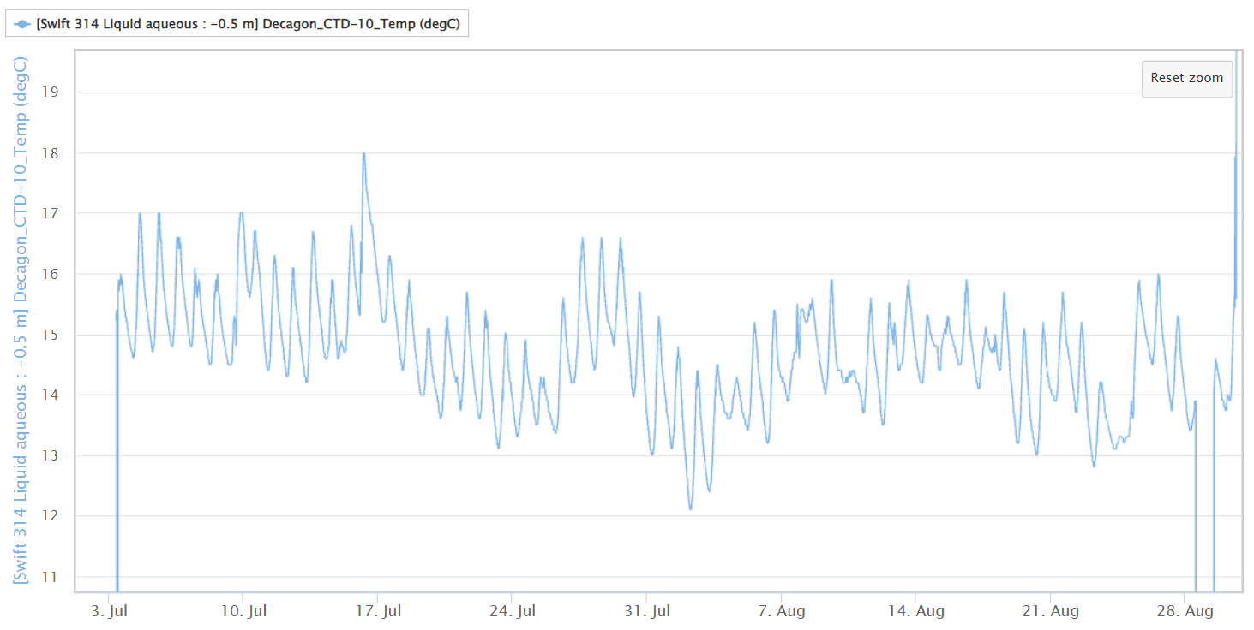
Swiftwater Creek (Swift 314)
Average Summer Water Temperature = 14.7 C°
PA DEP Maximum Stream Temperature for Cold Water Fish (66 F°, 19 C°)
Data error - disregard
Water Temperature (C°)
Data error - disregard
Data error - disregard
Date, year 2023

Slide 7
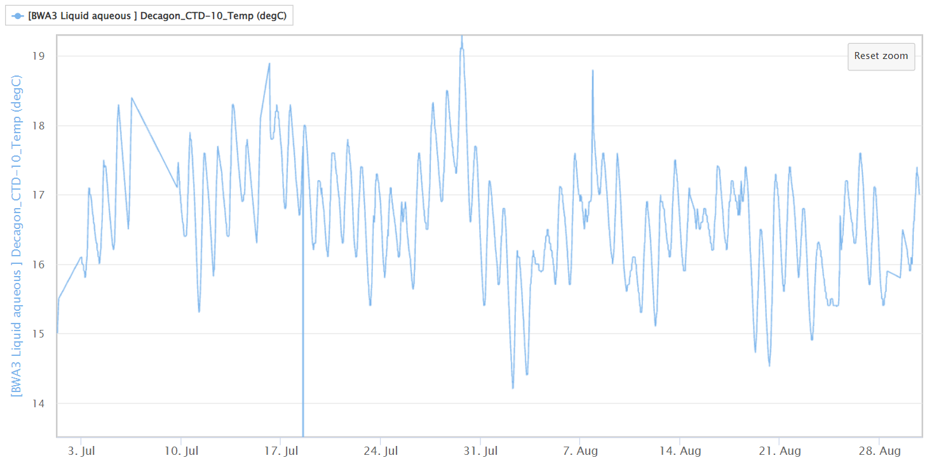
Lower Mill Creek (BWA3)
Average Summer Water Temperature = 16.6 C°
PA DEP Maximum Stream Temperature for Cold Water Fish (66 F°, 19 C°)
Water Temperature (C°)
Data error - disregard
Date, year 2023

Slide 8
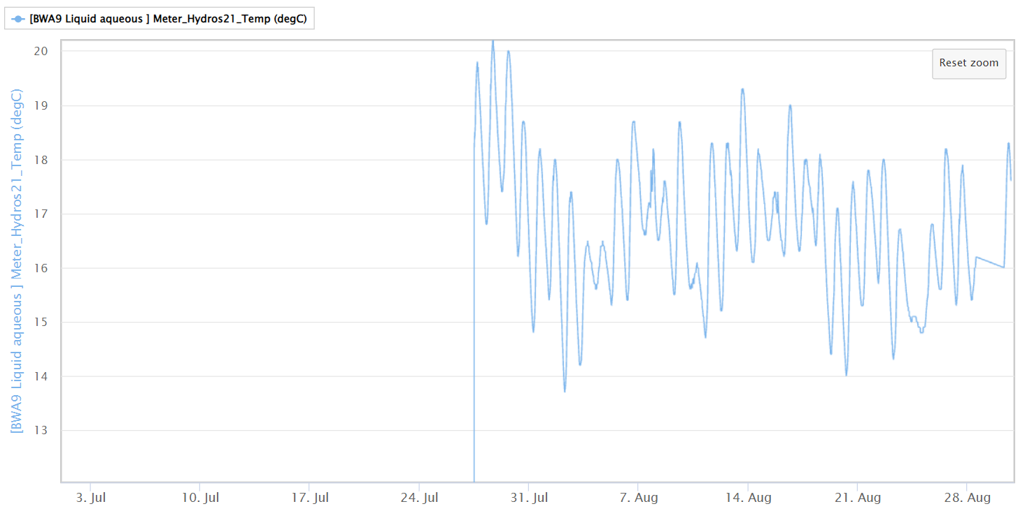
Upper McMichaels Creek (BWA9)
Average Summer Water Temperature = 16.8 C°
PA DEP Maximum Stream Temperature for Cold Water Fish (66 F°, 19 C°)
Water Temperature (C°)
*Note – incomplete data set (July was hotter so summer average may be >16.8 C°)
Data error - disregard
Date, year 2023

Slide 9
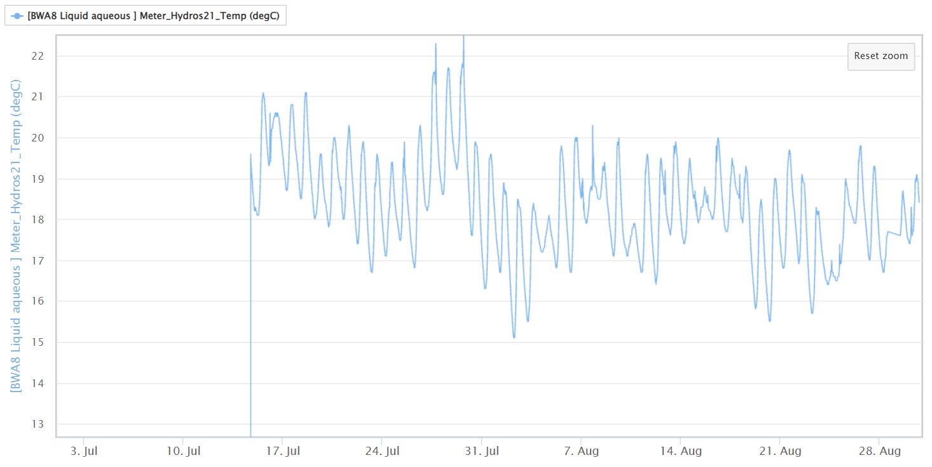
Pocono Creek at Tannersville Woods (BWA8)
Average Summer Water Temperature = 18.4 C°
PA DEP Maximum Stream Temperature for Cold Water Fish (66 F°, 19 C°)
Water Temperature (C°)
*Note – incomplete data set (July was hotter so summer average may be >18.4 C°)
Data error - disregard
Date, year 2023

Slide 10
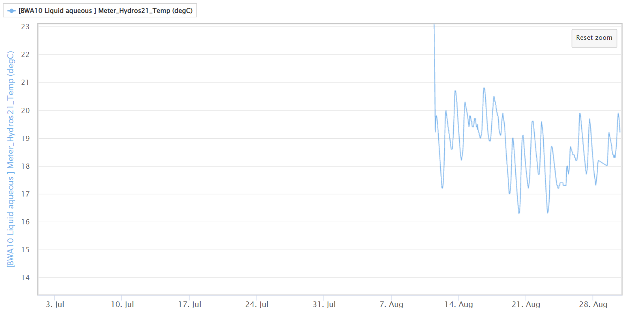
Marshalls Creek Falls (BWA10)
*Average Summer Water Temperature = 18.7 C°
Data error - disregard
PA DEP Maximum Stream Temperature for Cold Water Fish (66 F°, 19 C°)
Water Temperature (C°)
*Note – incomplete data set (July was hotter so summer average may be >18.7 C°)
Date, year 2023

Slide 11
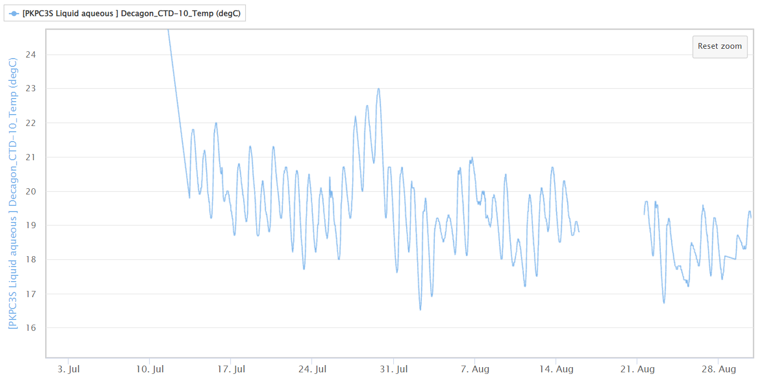
Paradise Creek above Brodhead (PKPC3S)
Average Summer Water Temperature = 19.4 C°
Data error - disregard
Water Temperature (C°)
PA DEP Maximum Stream Temperature for Cold Water Fish (66 F°, 19 C°)
*Note – incomplete data set (July was hotter so summer average may be >19.4 C°)
Date, year 2023

Slide 12
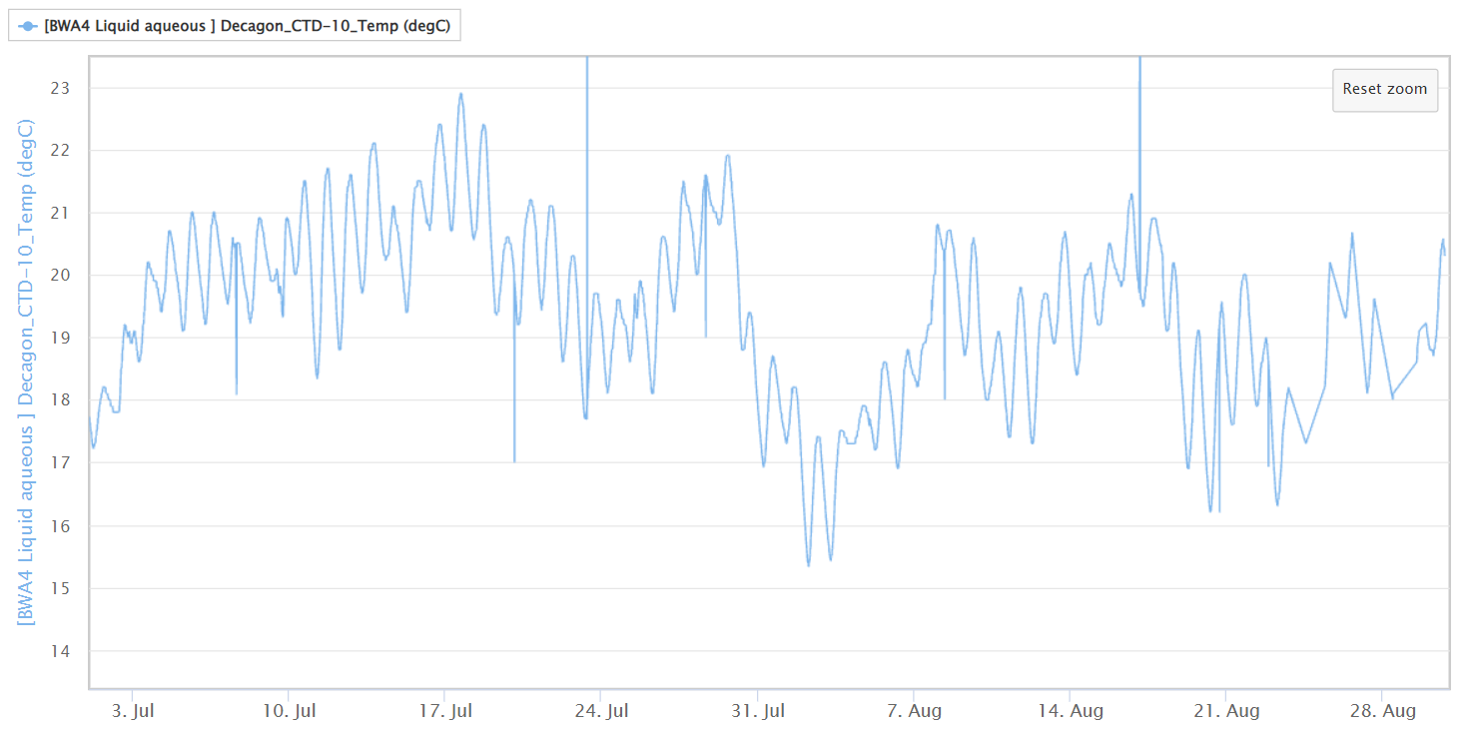
Butz Run (BWA4)
Average Summer Water Temperature = 19.4 C°
Data error - disregard
Data error - disregard
PA DEP Maximum Stream Temperature for Cold Water Fish (66 F°, 19 C°)
Water Temperature (C°)
Date, year 2023

Slide 13
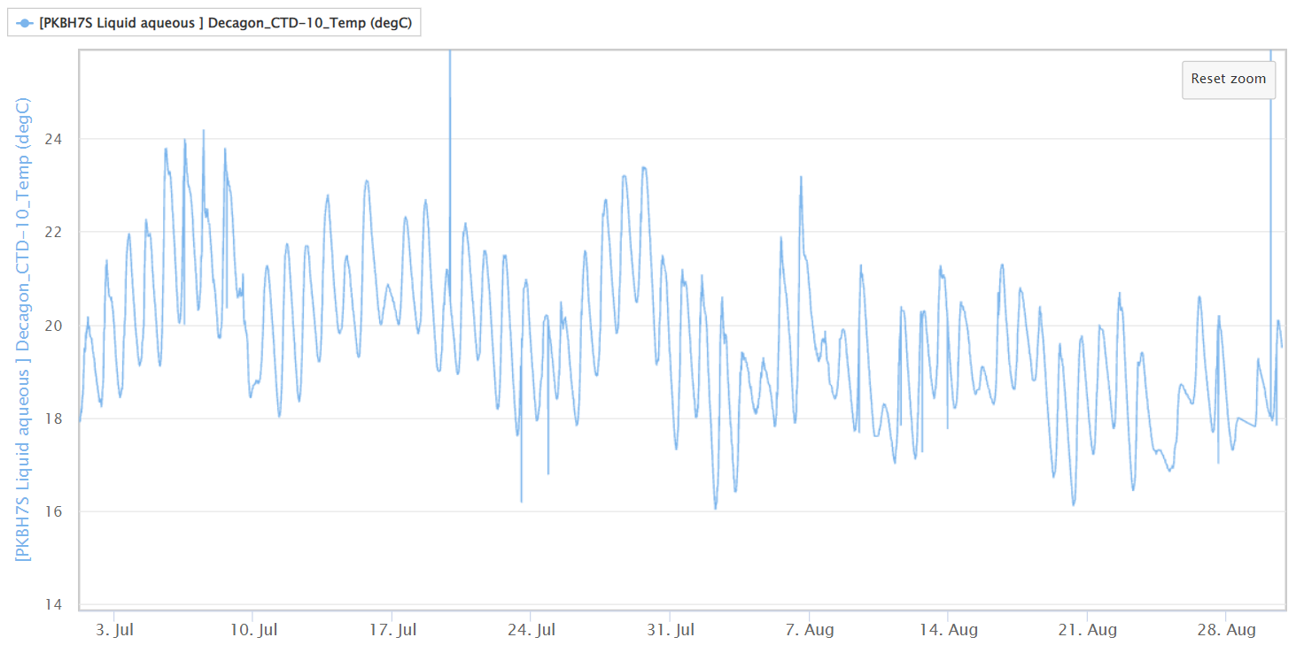
Brodhead Creek above Paradise (PKBH7S)
Average Summer Water Temperature = 19.7 C°
Data error - disregard
Data error - disregard
Water Temperature (C°)
PA DEP Maximum Stream Temperature for Cold Water Fish (66 F°, 19 C°)
Date, year 2023

Slide 14
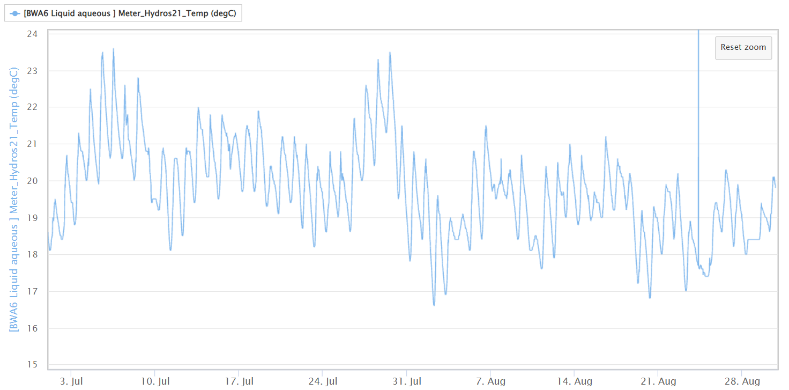
Pocono Creek at Rail Gap (BWA6)
Average Summer Water Temperature = 19.8 C°
Data error - disregard
Water Temperature (C°)
PA DEP Maximum Stream Temperature for Cold Water Fish (66 F°, 19 C°)
Date, year 2023

Slide 15
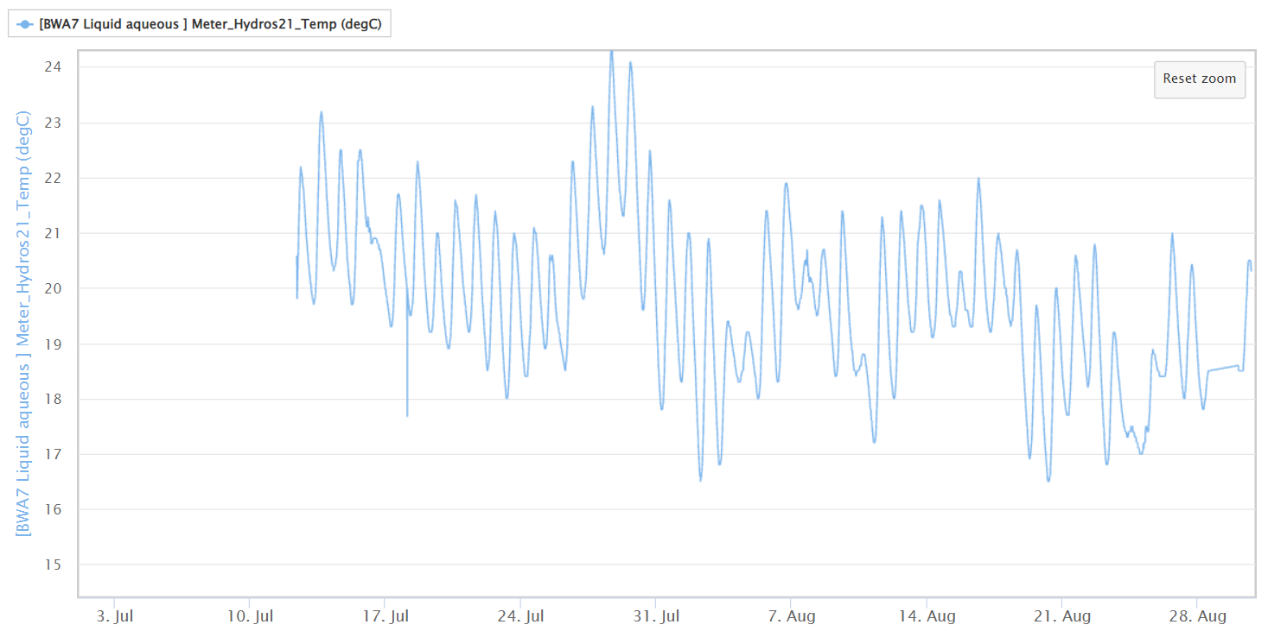
McMichaels Creek on Pomeroy (BWA7)
Average Summer Water Temperature = 19.8 C°
Water Temperature (C°)
PA DEP Maximum Stream Temperature for Cold Water Fish (66 F°, 19 C°)
*Note – incomplete data set (July was hotter so summer average may be >19.8 C°)
Date, year 2023

Slide 16
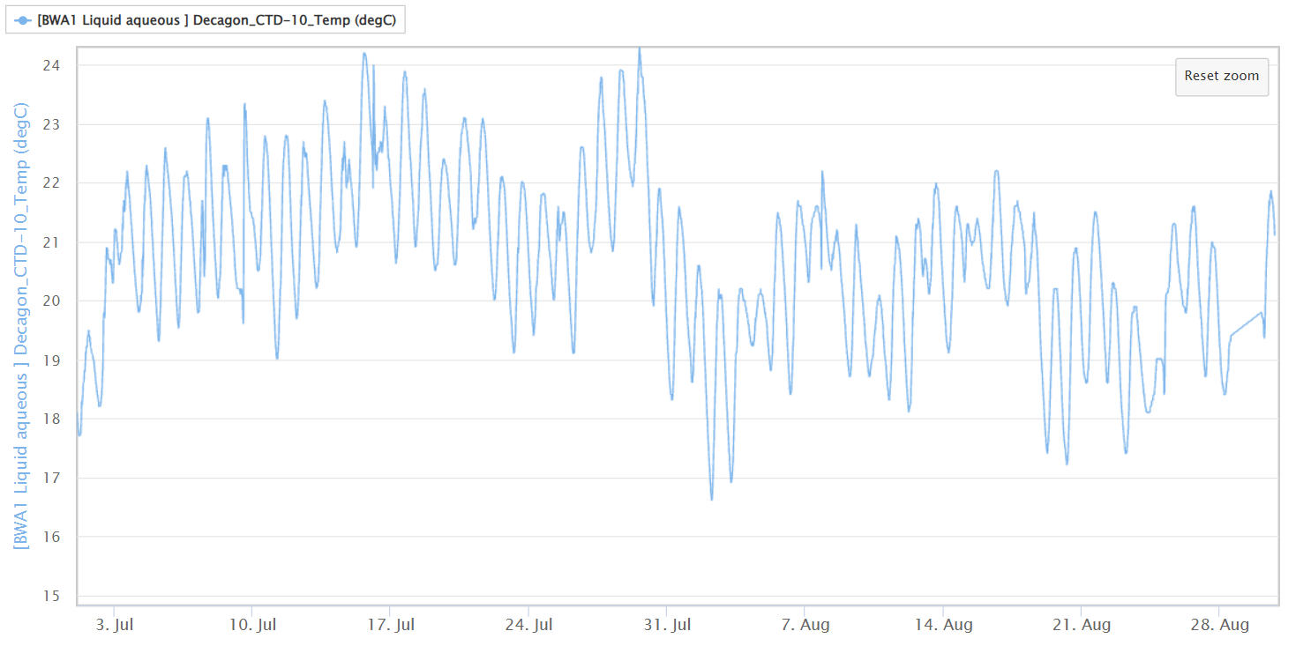
Forest Hills Run (BWA1)
Average Summer Water Temperature = 20.7 C°
Water Temperature (C°)
PA DEP Maximum Stream Temperature for Cold Water Fish (66 F°, 19 C°)
Date, year 2023

