Slide 1
Road salt use is much greater than decades ago.
Applied in the USA
Now 12x more than 1960 (25 MMT)
5x more 1970-1992 (10 MMT)
<2 MMT pre-1960

Slide 2


Road salt use is much greater than decades ago.
That salt is contaminating our streams
Applied in the USA
In local stream water
30x increase
10x increase

Slide 3
Road salt use is much greater than decades ago.
That salt is contaminating our streams
In local stream water
30x increase
Urban/Suburban
59% Developed
10x increase
Rural/Suburban
30% Developed
Rural
7% Developed

Slide 4
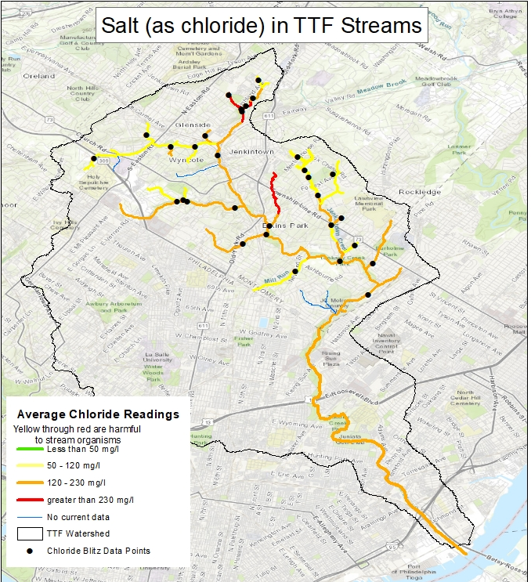
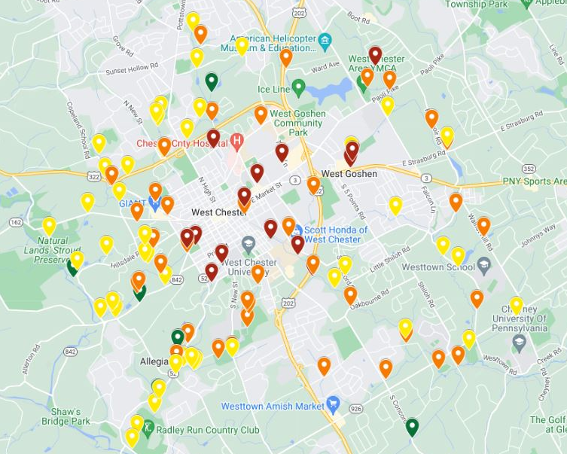
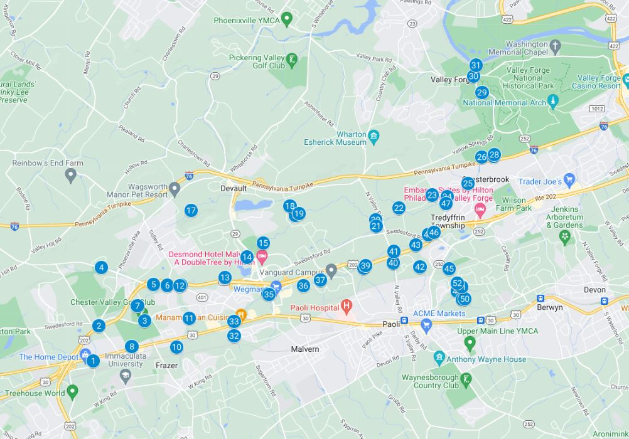
Salt concentration always elevated,
and highly variable - spatially
Plum, Blackhorse, Taylor, WB Chester
(108 sites)
Tookany/Tacony-Frankford Creeks
(31 sites)
Valley Creek
(52 sites)

Slide 5
Salt concentration always elevated,
and highly variable - spatially

Slide 6
Salt concentration always elevated,
and highly variable - temporally
TNC Stream Stewards
First State National Historic Park
Peaks at
20,000 to
40,000 μS/cm
Seawater
55,000 μS/cm

Slide 7
Salt concentration always elevated,
and highly variable - temporally
TTF Watershed Partnership
Shoemaker Run, Tookany Cr.
Peaks at
50,000 and
106,000 μS/cm
Seawater
50-55,000 μS/cm
28-30 Jan 2022

Slide 8
Salt concentration always elevated,
and highly variable - temporally
TTF Watershed Partnership
Shoemaker Run, Tookany Cr.
Peaks at
18,700 and
42,300 mg Cl/L
Seawater
50-55,000 μS/cm
28-30 Jan 2022

Slide 9
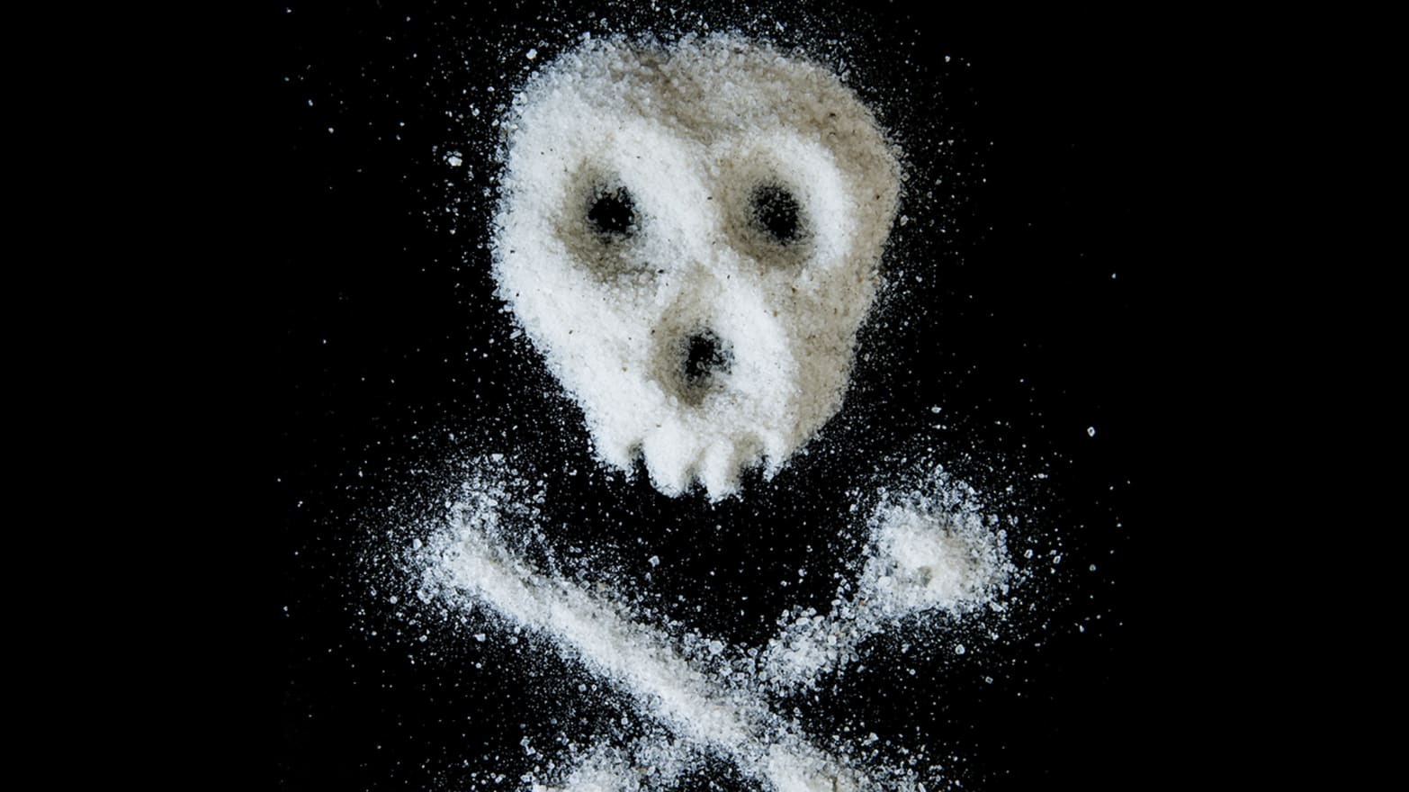
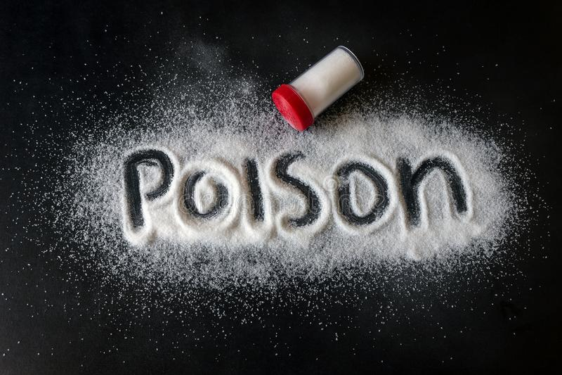
How much salt is too much salt?
https://www.thedailybeast.com/when-table-salt-becomes-poison?ref=scroll
https://www.dreamstime.com/salt-scattered-black-surface-written-word-poison-concept-healthy-food-diet-harm-to-health-excessive-consumption-image123514967

Slide 10
How much salt is too much salt?
Short term
640 mg Cl/L
Long term
120 mg Cl/L
Canadian Guidelines

Slide 11
How much salt is too much salt?
Short term
640 mg Cl/L
Long term
120 mg Cl/L
salt
1/4 tsp = 922 mg Cl
>50% of our sites

